Slide 1

Driving Sustainable Growth Across Africa
Presenter: Kalisa Jean Bosco
1

Slide 2
About KALI INVEST GROUP LTD
KALI INVEST GROUP LTD is a multi-disciplinary investment company committed to inclusive, sustainable, and innovative growth across Africa. Our mission is to build resilient communities, drive systemic change, and align with national and global development agendas.
2

Slide 3
Our Vision & Mission
Vision: To be Africa’s most trusted catalyst for sustainable and inclusive economic transformation.
Mission: To accelerate growth through innovative technologies, socially inclusive models, and impactful partnerships.
3

Slide 4
Our Strategic Pillars
🌍 Sustainability – Green housing, EV transition, renewable energy integration.
👥 Inclusivity – Empowering women, youth, MSMEs, and vulnerable groups.
💡 Innovation – Driving digital trade, fintech, creative economy, and smart mobility.
1

Slide 5
Strategic Pillars in Action
Sustainability 🌍 → Agriculture, Real Estate, E-Mobility Inclusivity 👥 → Finance, MSMEs, Community Programs Innovation 💡 → ICT, Media, Advisory Each pillar is embedded across all subsidiaries, ensuring both economic growth and long-term impact.
2

Slide 6
Alignment with National & Global Goals
Rwanda Vision 2050
National Strategy for Transformation (NST1)
Sustainable Development Goals (SDGs)
African Continental Free Trade Area (AfCFTA)
5

Slide 7
Subsidiaries Overview
🏗️
N&R Real Construction Ltd
Infrastructure & Housing
💰
Jet Speed Money & Insurance
Fintech & Micro-Insurance
🚖
Kigali E-mobility Transport
Green Transport
🏠
Formula 1 Real Estate
Real Estate Development
📊
East Africa Business Advisory
Consulting & Research
☕
Mood Café & Spirits
Hospitality & Lifestyle
🎬
Kigali Creative Arts & Media
Creative Economy
🌱
East Africa Agriculture & Circular Platform
Agriculture

Slide 8
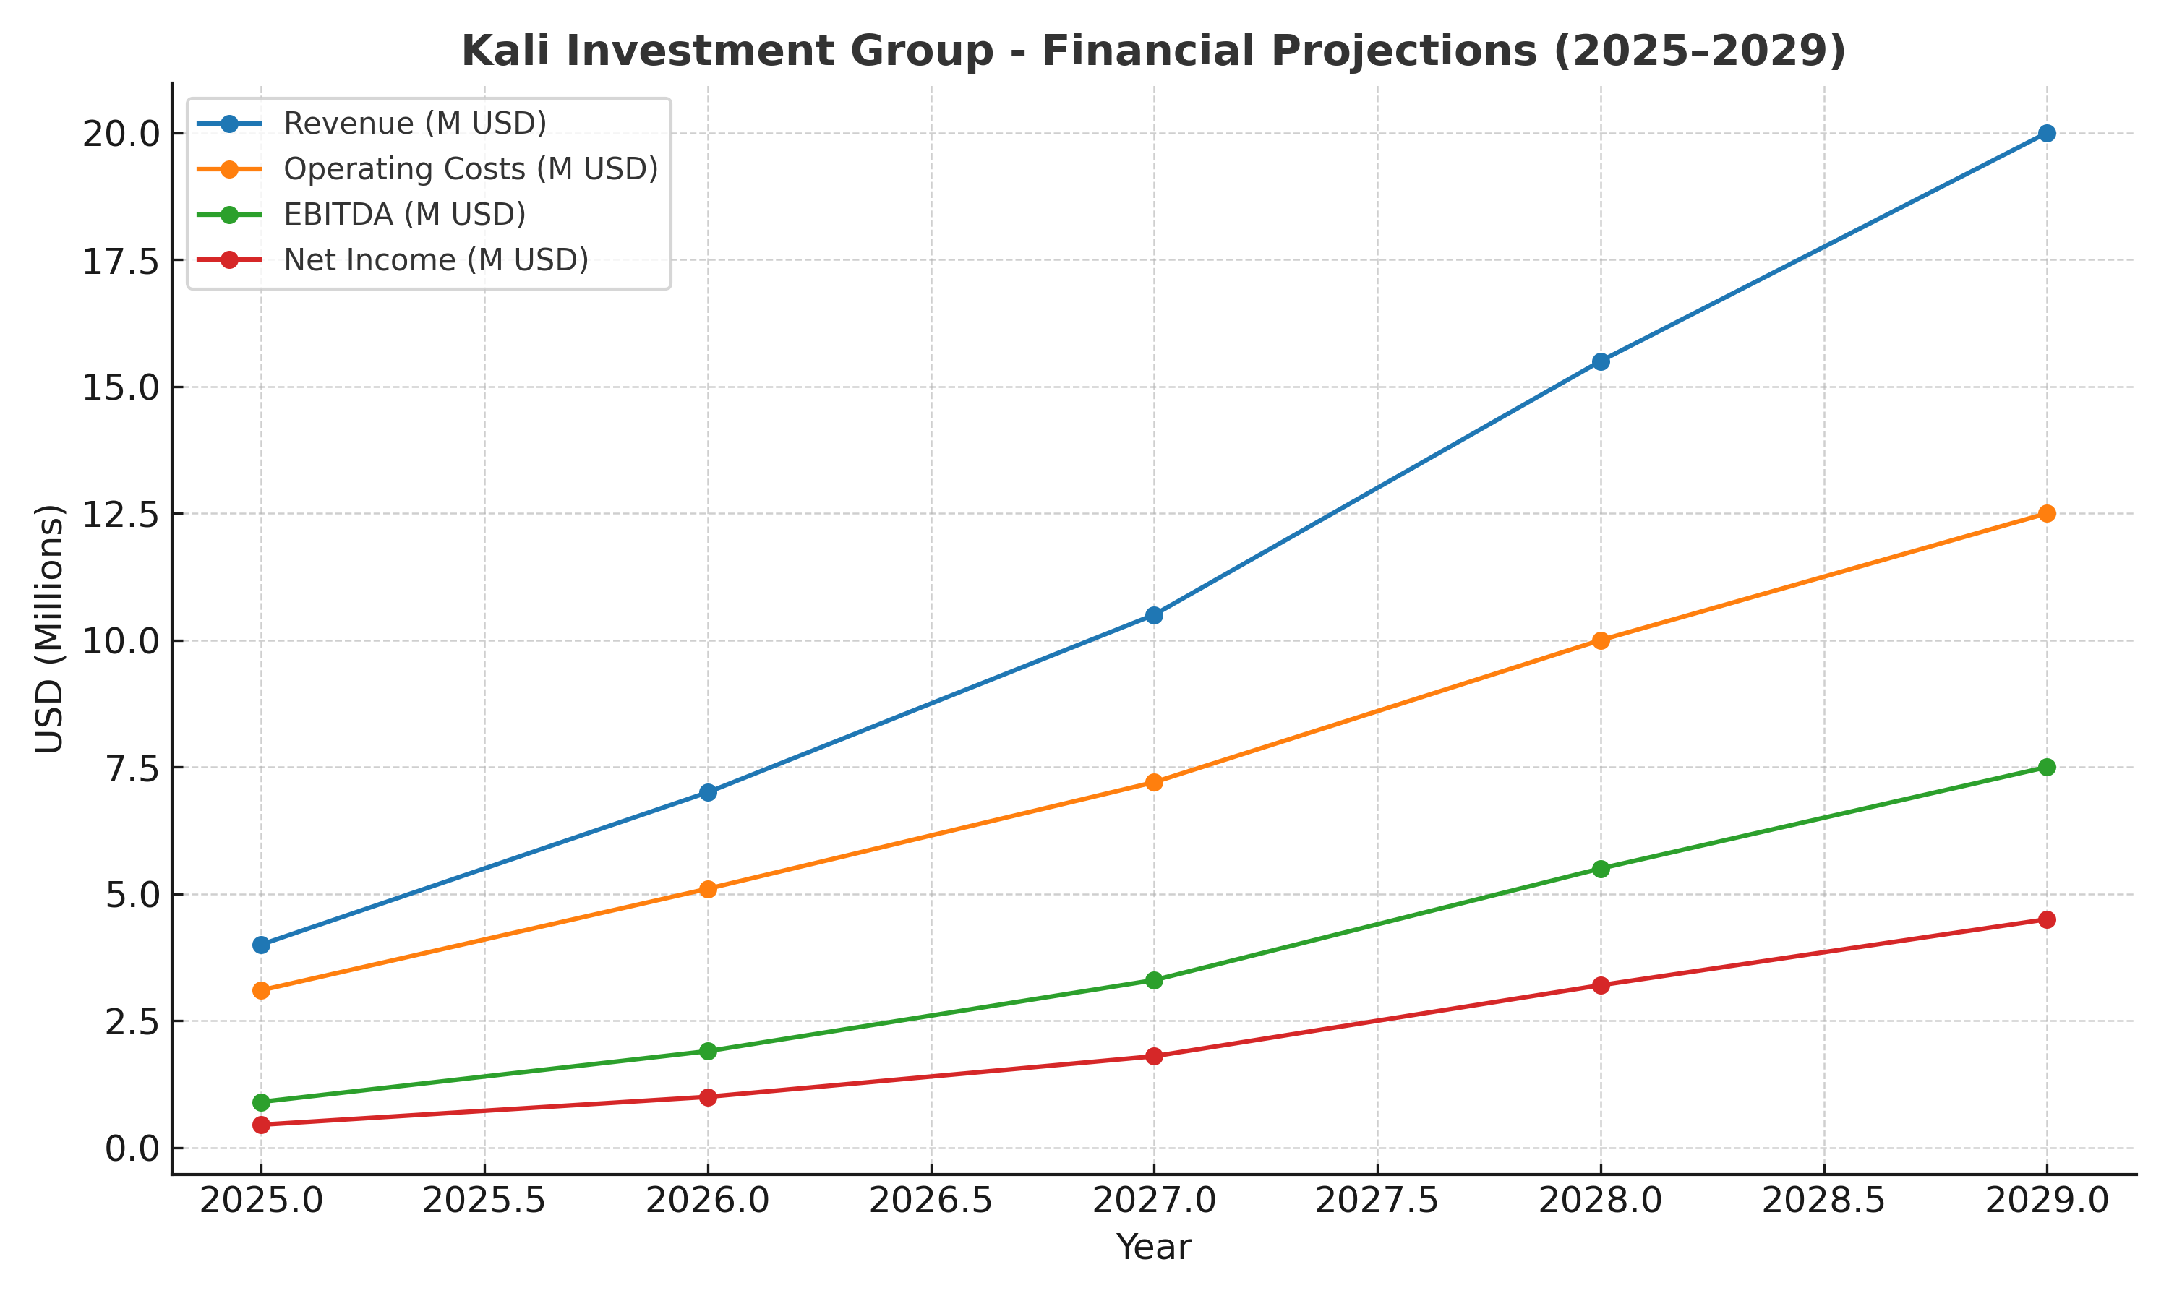

Slide 9
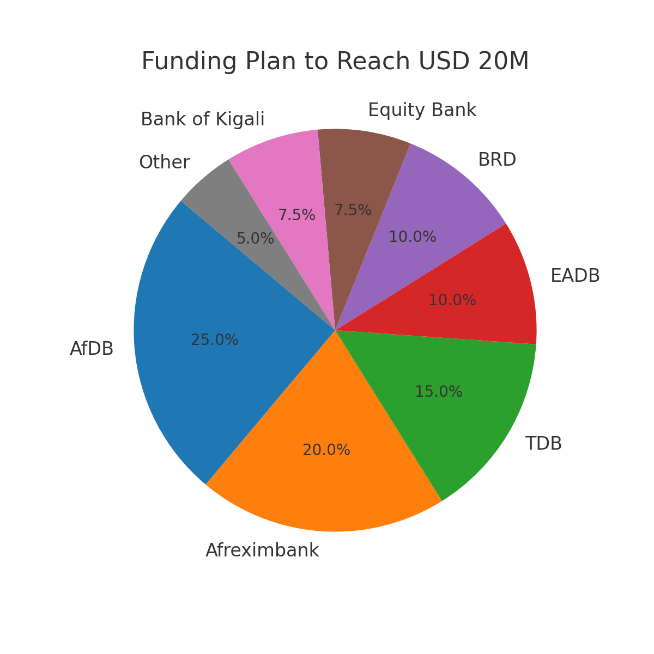
Diversified funding from DFIs, national banks, and grants to reach USD 20M target.
9

Slide 10
Expansion Roadmap (2025–2030)
Phase 1 (2025–2026)
Rwanda Depth – Kigali, Musanze, Huye.
Phase 2 (2027–2028)
National Coverage – Rubavu, Rusizi.
Phase 3 (2029–2030)
Regional Integration – Kampala, Bujumbura.

Slide 11
Expected Economic Impact
Direct Jobs: 500+ by 2029
Indirect Jobs: 1,500+ by 2029
MSMEs Financed: 1,600+ by 2028, scaling to 3,000+ regionally
Contribution to Rwanda’s GDP: Catalytic role in transport, housing, and finance
11

Slide 12
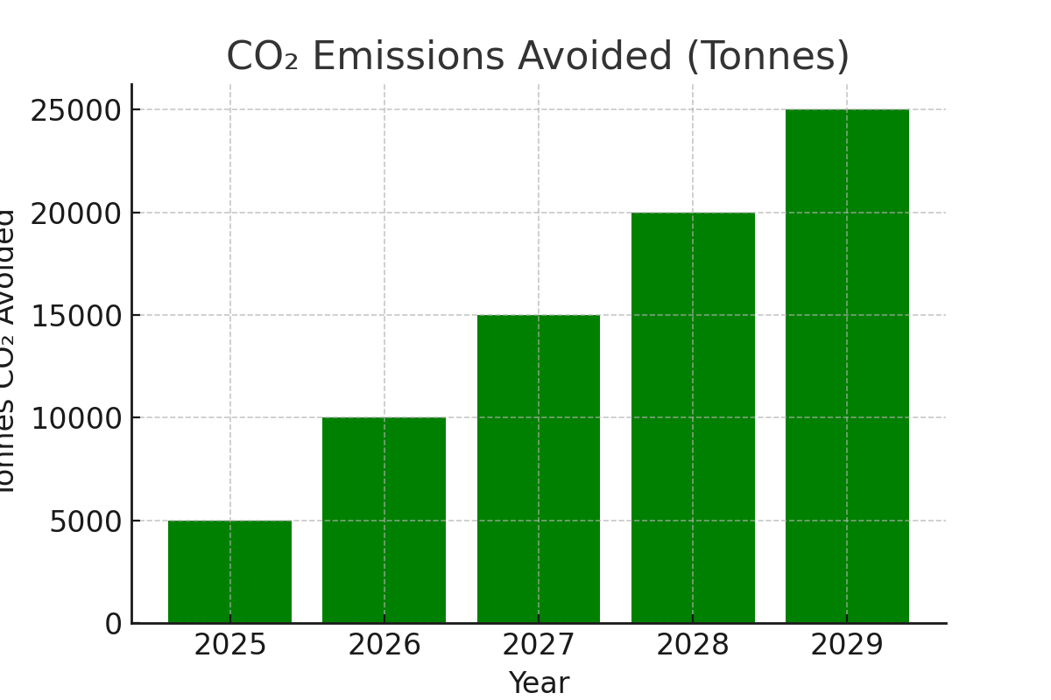
Environmental Impact
By 2029, KALI aims to reduce up to 25,000 tonnes of CO₂ annually through EV transition and green projects.
12

Slide 13
Annual Impact Scorecard (2025–2029)
Indicators Tracked:
Jobs Created (direct + indirect)
CO₂ avoided (tonnes)
SMEs Financed
Affordable Homes Delivered
EV-km Electrified
Women & Youth Participation (%)
Local Supplier Spend (%)
13

Slide 14
Social Impact
Women Empowerment: 40% of jobs targeted for women
Youth Inclusion: Training programs for 2,000+ young people
Vulnerable Groups: Integration into circular economy projects
•Affordable Housing: 250+ green housing units delivered
14

Slide 15
Philanthropic & Community Interventions
Job creation for women and vulnerable groups
Skills training and entrepreneurship incubation
Community infrastructure (schools, clinics, centers)
NGO partnerships for sustainable, high-impact programs
15

Slide 16
Investor Value Proposition
Integrated platform with multi-sector synergies
De-risked growth aligned with DFIs & AfCFTA
Impact embedded (jobs, housing, EV transition)
Investor-ready with CAGR 41% to 2029
Strong regional expansion model
16

Slide 17
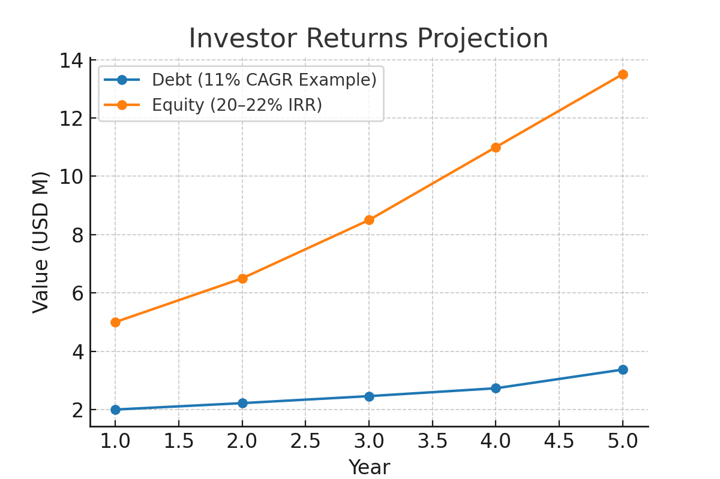
Debt, mezzanine, and equity investors benefit from attractive annualized returns, with strong security and cashflow cover.
17

Slide 18
Risk Controls & Break-Even
Break-even achieved by mid-2026
Portfolio risk: PAR30 < 5%
Hedging strategies to manage FX and interest risks
Diversified cashflows, receivables cover, ESG covenants
18

Slide 19
Strategic Partners & Comparative Advantage
AfDB
Afreximbank
Green infra lines → ESG pipeline visibility
Trade/project → Multi-country scaling
KALI
INVESTMENT GROUP
TDB
EADB
Lending → Multi-sector de-risking
SME finance → Proven origination analytics
Equity/BK
BRD
Telcos
WC/loans → Cross-sell + collections
National housing → Local
impact linkage
Digital rails → Embedded finance

Slide 20
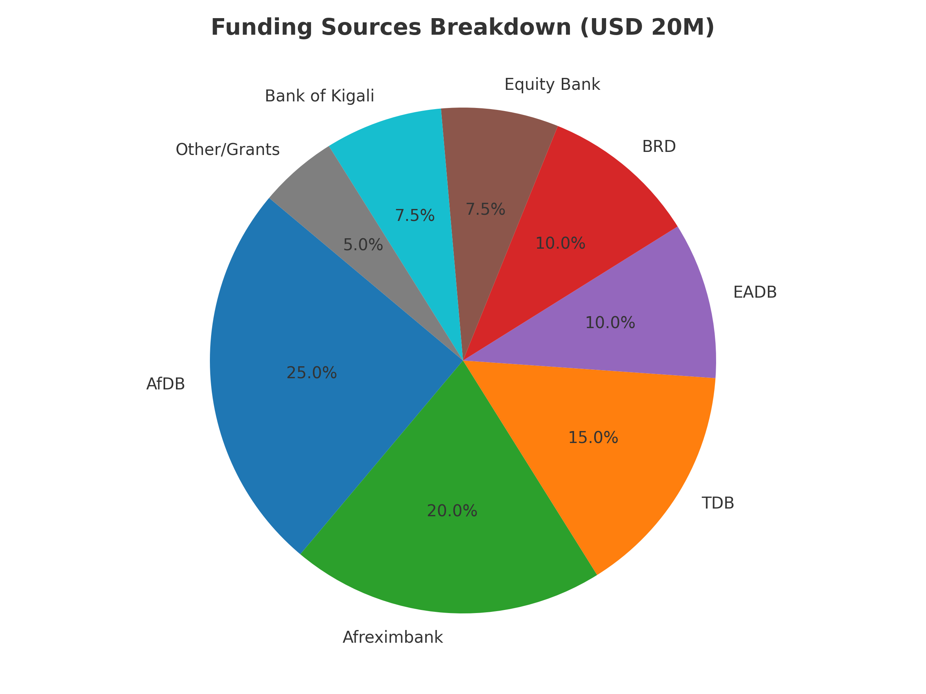
Funding Agencies & Pipeline
20

Slide 21
Expansion Drive (2025–2030)
Phased expansion strategy:
Depth First in Rwanda (2025–2026)
National Coverage (2027–2028)
Regional Scaling to EAC & AfCFTA (2029–2030)
21

Slide 22
Phase 1: Rwanda Depth (2025–2026)
Consolidate Kigali operations
Launch in Musanze & Huye
200 EVs deployed, 60 housing units, 600 MSMEs financed
22

Slide 23
Phase 2: National Expansion (2027–2028)
Expand into Rubavu & Rusizi
Regional depots for EV fleets
360 EVs, 180 housing units, 1,600 MSMEs financed
23

Slide 24
Phase 3: Regional Expansion (2029–2030)
Entry into Uganda (Kampala) and Burundi (Bujumbura)
Joint ventures & AfCFTA trade corridor linkages
500 EVs, 250 housing units, 3,000 informal workers integrated
24

Slide 25
Regional Value Chains & AfCFTA
Integration of agriculture, mobility, and digital finance value chains
Leveraging AfCFTA corridors for exports and services
Building resilience against external shocks via diversification
25

Slide 26
Research & Knowledge Products
Women & youth in trade
Climate change & circular economy
Access to finance for startups
Digital trade, creative industries, and payments research
26

Slide 27
Thought Leadership & Public Speaking
Signature Talks:
1. Financing EV transition in African cities
2. Green & affordable housing
3. Circular value chains for farmer incomes
4. AfCFTA routes for MSMEs
5. Data-driven ESG for capital access
KPIs: 10+ talks/year, 15+ media mentions, 2 white papers/year
27

Slide 28
A New Voice for MSMEs
Advocacy on barriers facing African MSMEs
Unlocking access to finance & digital trade tools
Mobilizing funding for startups & creative industries
Policy dialogue & awareness creation
Promoting digital currencies & new payment systems
28

Slide 29
Community & Philanthropy
Job creation for women & vulnerable groups
Skills training & entrepreneurship incubation
Co-funding social enterprises
Infrastructure for schools, clinics, and centers
29

Slide 30
Why Invest with KALI
Multi-sector diversification
Strong regional expansion model
Impact-focused and ESG-compliant
Investor-ready with clear CAGR targets
Rwanda-first with AfCFTA scalability
30

Slide 31
Closing & Contact
Thank you for your attention.
CEO: Kalisa Jean Bosco Email: kalinvestment@gmail.com Phone: +250 788 305 943
31

